Slide 1
PPH at the Israel Patent Office
Gershon Jochnowitz, Patent Examiner, ILPO
November 26th, 2014

Slide 2
Expedited Examination Routes– out of turn
Out of turn expedited examination routes in accordance to Article 19(a) of the law, have been formulated in order to:
  Enhance legal certainty of the public and the applicant by reducing the wait time until the first Office Action
  Facilitate prospective enforcement
  Promote public interest (relating to the old, promoting CleanTech, etc.)
  Share work products, thereby reducing duplications and backlogs

Slide 3
Expediting routes at the ILPO
Affidavit | Indication of patentability in a corresponding application | Fee
form | + | - | PPH
+ | - | - | Age/Medical condition
+ | - | + | Public benefit
+ | - | + | Third party R&D delay
+ | - | + | IL Priority Claim (Commissioner’s Notice 28/11/2010) * Office action available in English
- | - | - | Green Invention
+ | - | + | Suspected infringement
* The applicant is not required to be an Israeli citizen
Notes:
It is possible to accelerate the examination via the commissioners notice, and then use the PPH in a corresponding authority.

Slide 4
Types of PPH
PPH: Relies on work products done by a national authority.
PCT-PPH: Relies on work products done by an International authority.
MOTTAINAI (PPH/PCT-PPH): Doesn’t require that the priority application be applied at the OEE.
GPPH: A pool of authorities that apply PPH and PCT-PPH (MOTTAINAI) between them. The GPPH uses a single set of requirements and its aim is to simplify and improve the existing PPH arrangements therefore making the PPH more accessible to the applicants.

Slide 5
PPH Requirements
Eligibility Requirements
The applications before the Office of Earlier Examination (OEE) and the Office of Later Examination (OLE) have the same earliest date (which may be the priority date or the filing date).
The OEE has found at least one claim to be allowable.
All claims presented for examination under the PPH pilot must sufficiently correspond to one or more of the claims found allowable by the OEE
The OLE has not begun substantive examination of the application.

Slide 6
PPH Requirements
Supporting documentation required for PPH request:
A completed PPH request form;
A copy of the work product(s) which are relevant to the allowability of the claims of the corresponding OEE application, if not available via Dossier Access Systems; and
A copy of the claims found to be allowable by the OEE, if not available via Dossier Access Systems.
Offices may also require the applicant to provide the following documentation:
Copies of citations raised against the OEE application which are not available to the OLE via their regular databases or search files;
Translations of any of the documents, and
A claim correspondence table that shows the relationship between the claims of the OLE application and those of the OEE application that were considered allowable.

Slide 7
About the formal examination in the PPH
Fast formal examination.
In order to further expedite the substantial examination, the substantive examiner’s contact details are mentioned in the Office Action.
Only one chance to amend.
Examination guidelines have been updated and are public online.
Common Q&A have been updated and are public online.
Adoption of a common GPPH form will take place early 2015.
Plans for raising awareness to the PPH through notifying applicants in “Confirmation of submission notice” and “Notice before allowance”.
Considering allowing postponing of examination in favor of PPH requests
Redesigned PPH web page.
Notes:
If there is time, show them the web page

Slide 8
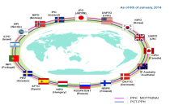










PPH arrangements at the ILPO
  GPPH
  United States of America (PPH and PCT-PPH)
  China (PPH and PCT-PPH)
  Denmark (PPH and PCT-PPH)
  Japan (PPH and PCT-PPH)
  Finland (PPH and PCT-PPH)
  Canada (PPH)
  South Korea (PPH and PCT-PPH)
  Spain (PPH and PCT-PPH)
  Israel (PCT-PPH)
  EPO (2015, In process)
Notes:
We were one of the first to join the GPPH

Slide 9
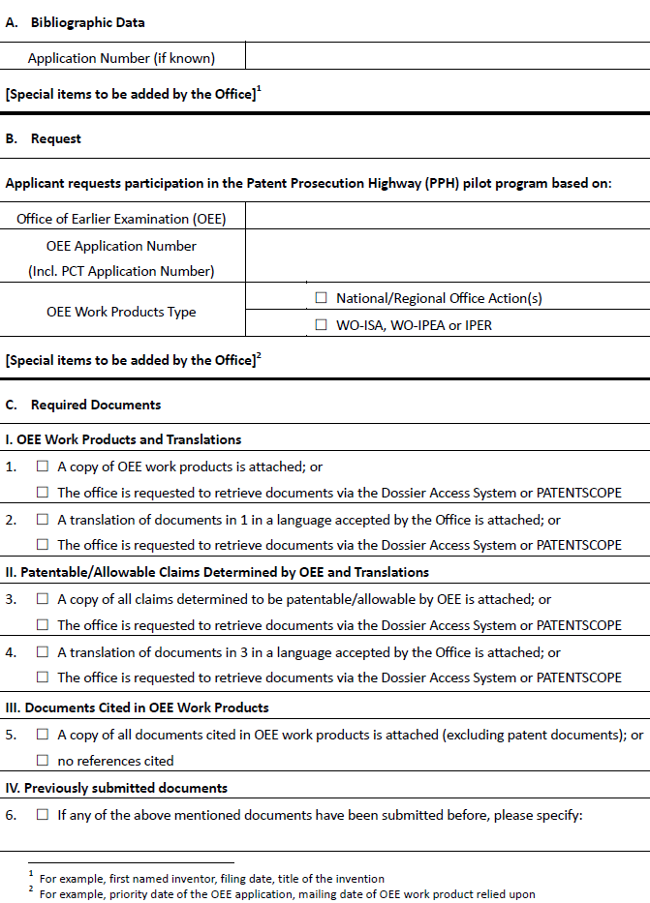
Common PPH Request Form 01/2015

Slide 10
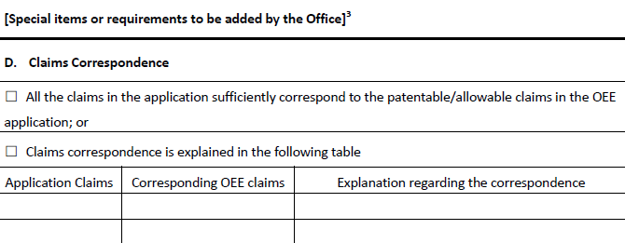
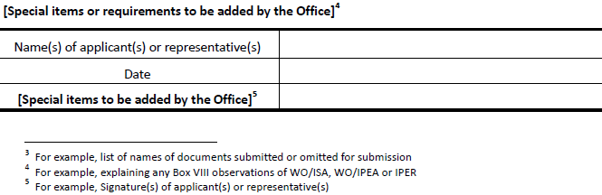
Common PPH Request Form 01/2015

Slide 11
PPH Applications by classification - 2014
A Human Necessities
B Performing Operations ;Transporting
C Chemistry ;Metallurgy
D Textiles ;Paper
E Fixed Constructions
F Mechanical Engineering ;Lighting ;Heating ;Weapons ;Blasting
G Physics
H Electricity

Slide 12
2014 Applications by type of PPH Arrangement

Slide 13
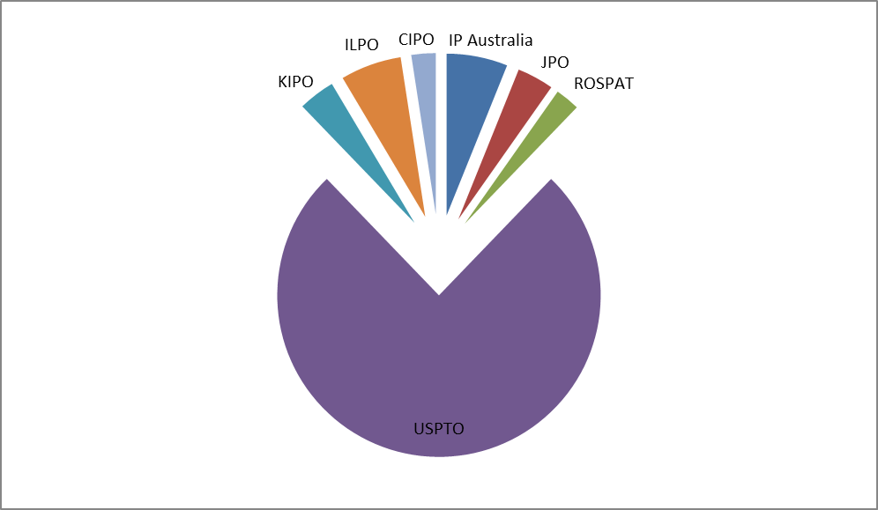
2014 Applications by Country Of First Examination

Slide 14
PPH Requests by the Agent

Slide 15
Applications by year

Slide 16
Use of ILPO work products by other Patent Offices
Number of PPH requests (using ILPO products)
Total | Russia | Australia | Canada | U.S.A. | Office
10 | 2 | 2 | 4 | 2 | Number
* As of June 2014
Number of PPH requests (using ILPO-PCT products)
Total | Israel | Japan | U.S.A. | Office
21 | 3 | 3 | 15 | Number
* As of June 2014

Slide 17
ILPO PPH Status Report
Average no. of Office Actions | Average Pendency from PPH Request to Final Decision (months) | Average Pendency from PPH Request to First Office Action (months) | First Action Allowance Rate (%) | Route
0.7 | 3.8 | 2.0 | 53.5 | PPH
0.8 | 3.3 | 1.3 | 57.1 | PCT-PPH
* Almost no rejections during 2014
Notes:
* Many of the applications also request modified examination by 17c.
Grant rate isn’t showed due to not having enough applications to anticipate a realistic figure.

Slide 18

Possible Effects of Expedited Examinations
Possible Effects on ILPO
  Reduce backlog
  Reduce duplication in search and examination
  Work-product sharing with foreign PTOs
Possible effects on Applicants and Public
  Higher legal and business certainty
  A more user friendly patent system due to the harmonization
  Reduction in costs due to less office actions

Slide 19
Modified Examination Routes– “In turn” examination
“In turn” modified examination routes have been formulated in order to:
  Enhance the public’s and the applicant’s legal certainty through harmonization
  Reduce the PTO’s work load
Includes Article 17c and Commissioner Circular M.N 70
Modified examination and Expedited examination are not dependent and can be used together or separately

Slide 20

  PPH@justice.gov.il

